Slide 1
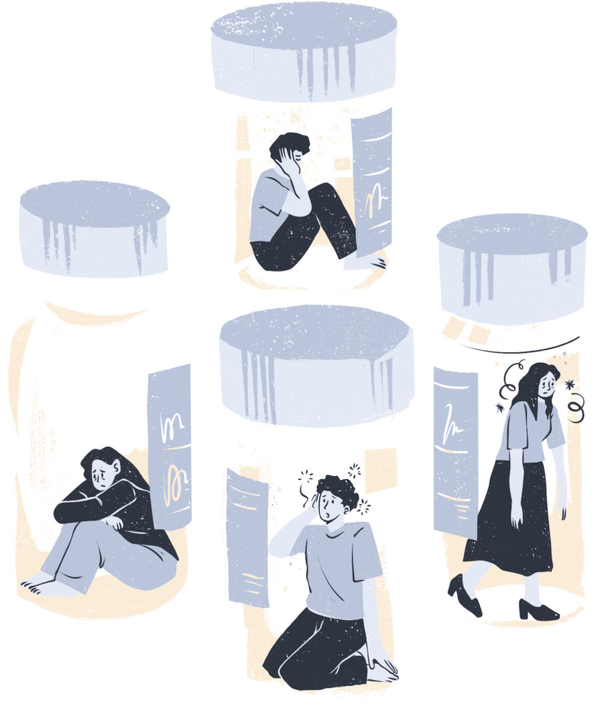

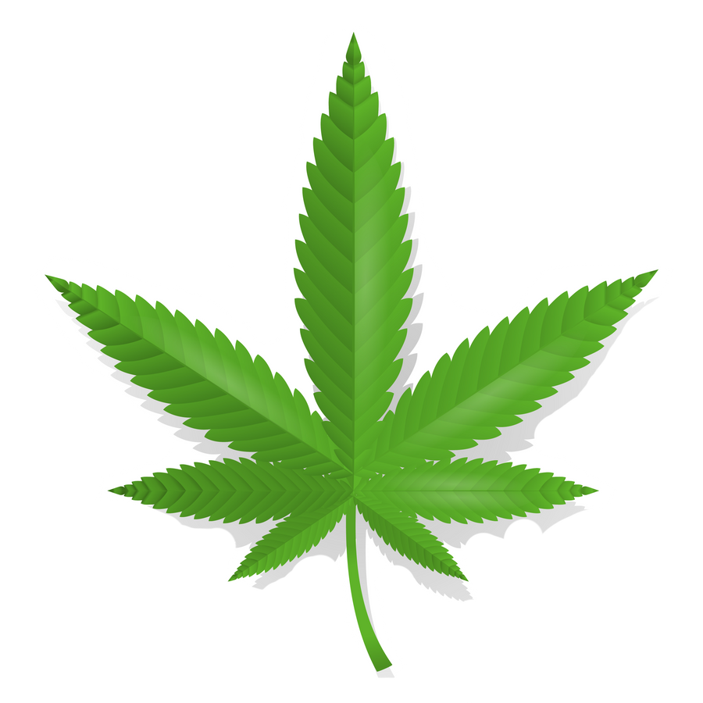
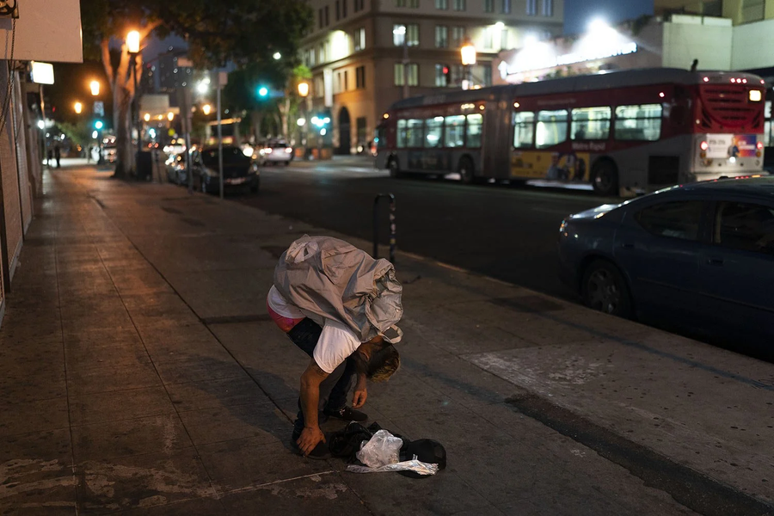
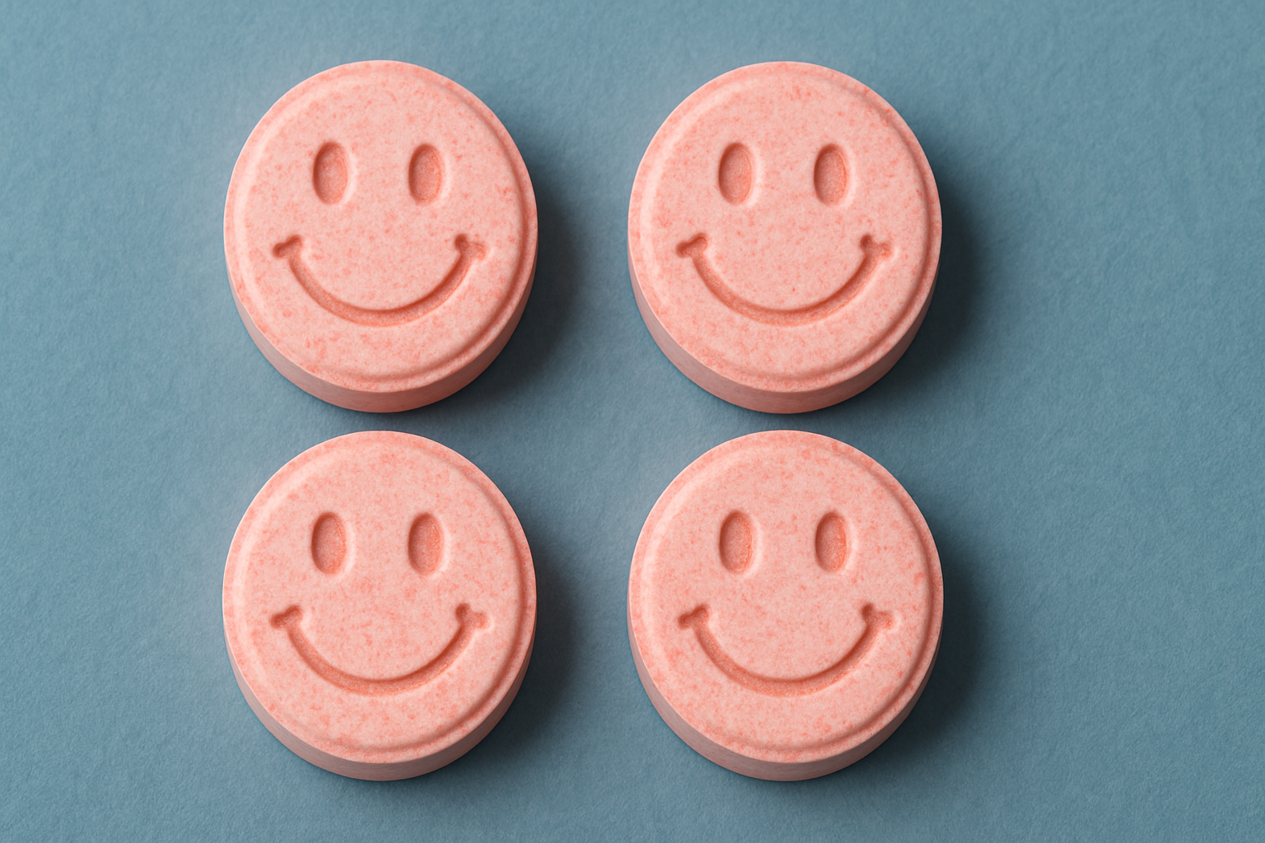
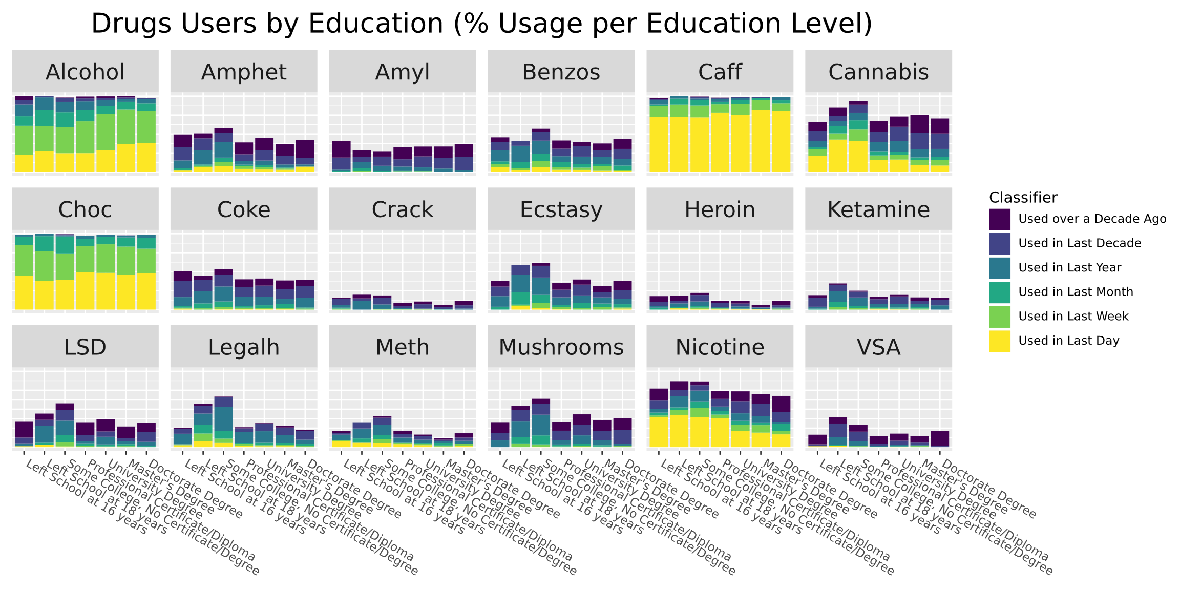
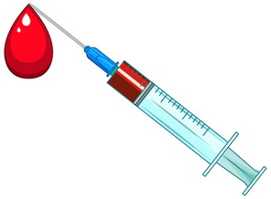
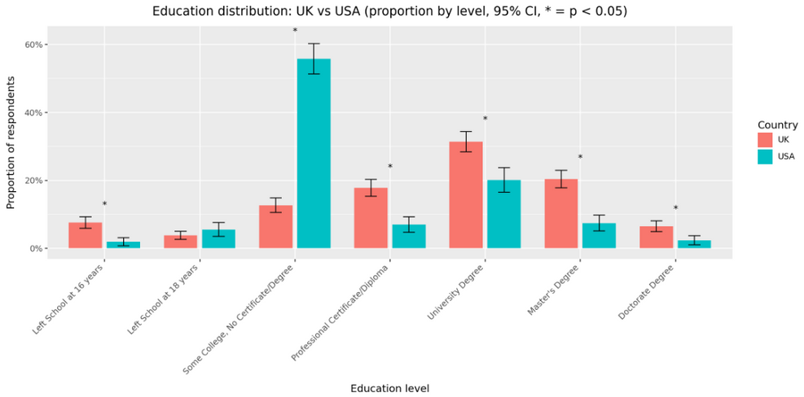
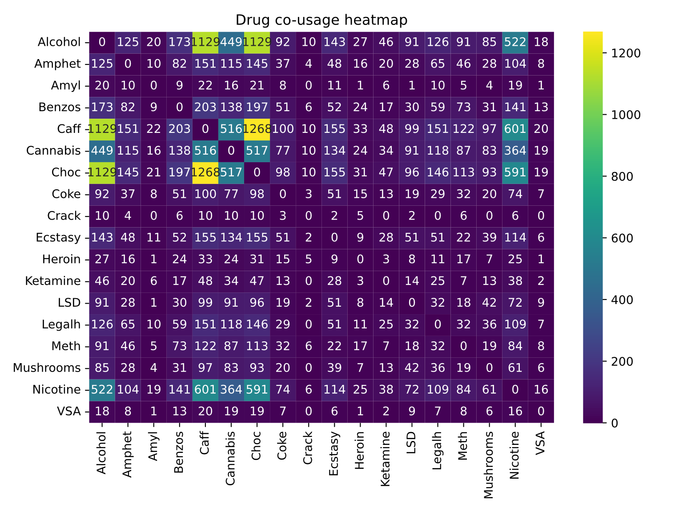
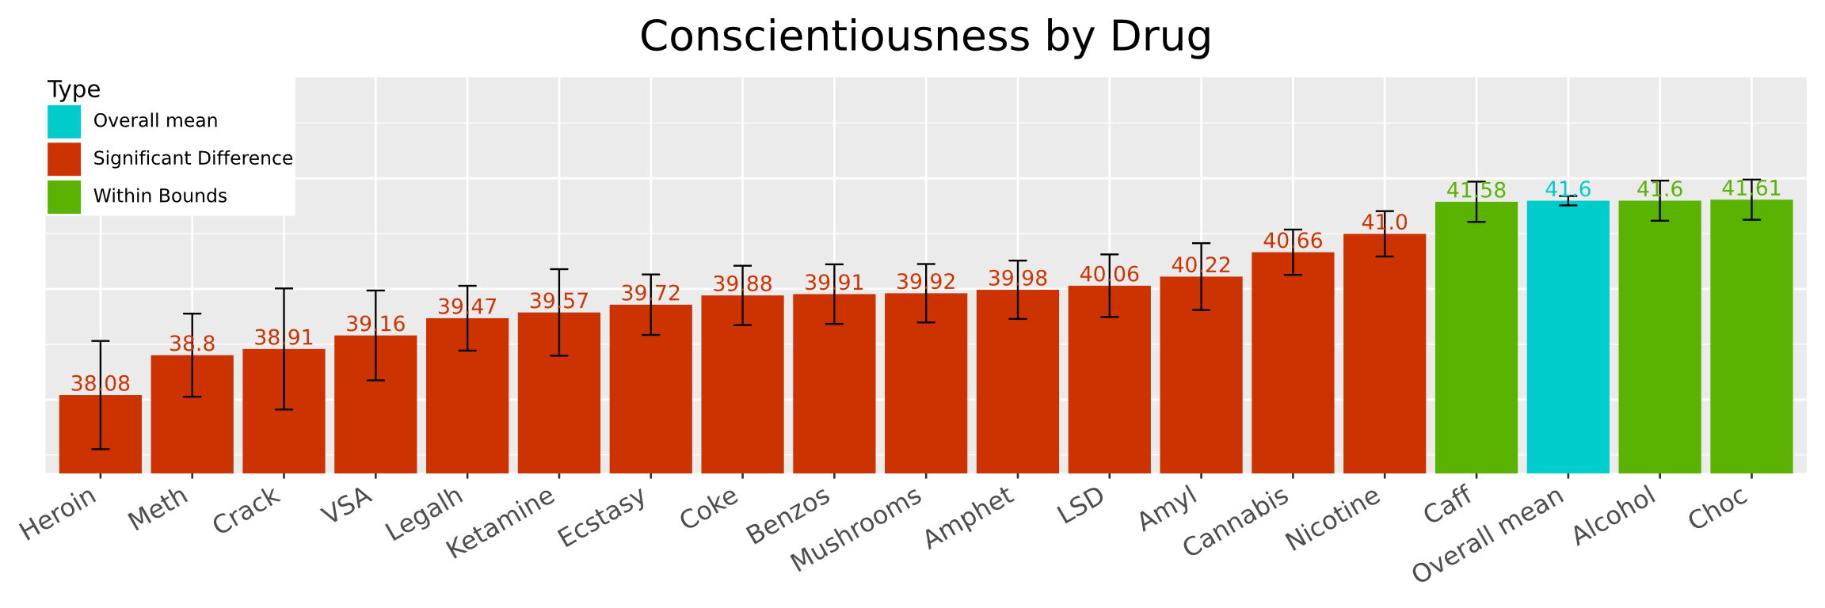
Drug Use & Personality Analysis:
B12 - Exploring the Link Between Personality Traits and Substance Use - Hannes Jaakson & Richard Miikael Jaks
https://pngimg.com/image/16510
(www.freepik.com)
Fentanyl user
The dataset is from Kaggle. It contains demographic variables (age, gender, education, country, ethnicity) and detailed drug-use histories across six levels of use, ranging from never used to used in the last day. It also includes personality measures such as the Big Five traits, impulsivity, and sensation seeking, (table above) which help explain individual differences in behavior. Data was cleaned by removing all countries other than US and UK, removed all rows with drug “semeron”, since it was a made up drug to get over-achivers. Left school at 16 years includes now everyone who left school before 16 years and the same is with 16-18 years. https://www.kaggle.com/datasets/mexwell/drug-consumption-classification/data
The motivation for this project comes from both of the authors interest in data drivben information about narcotics users.
Goal 1: Data mining and cleaning – prepare and preprocess the dataset for analysis.
Goal 2: Analyze relationships between personality traits, demographics, and drug use; explore links between different substances and cluster individuals by behavioral similarity.
Goal 3: Visualize results and draw conclusions about patterns and predictors of drug use.
https://apimagesblog.com/blog/2022/11/29/fentanyls-scourge-plainly-visible-on-streets-of-los-angeles
chatGPT image
Patterns show a clear divide between universally used substances (alcohol, caffeine, chocolate) and niche or high-risk drugs, whose users cluster into distinct behavioral groups. The near-absence of recent use for substances like VSA and Amyl („Poppers“) likely reflects strong social desirability bias or underreporting rather than true scarcity.
Trait | Explanation | High Scores | Low Scores
Neuroticism | Emotional sensitivity | More stress, mood shifts | Calm, stable
Extraversion | Sociability level | Energetic, outgoing | Quiet, reserved
Openness | Curiosity, creativity | Imaginative, open | Prefers routine
Agreeableness | Cooperation style | Friendly, trusting | Tough, skeptical
Conscientiousness | Self-discipline | Organized, reliable | Flexible, less structured
Impulsivity | Acting without thinking | Spontaneous | Careful
Sensation | Response to sensory input | Likes strong stimulation | Prefers calm
(www.freepik.com)
KEY INSIGHTS
Women use less drugs, especially hard drugs
College dropouts do the most drugs, especially legal highs, nicotine and cannabis
Young people drink more often, but everyone drinks about the same every month.
Older people smoke nicotine more, while younger addicts prefer cannabis more.
Young people in general do more drugs.
In general, drug users almost always had significantly different personality traits.
Comparison to mean of all drugs. p = 0.05
Users of Heroin, Meth, VSA, Benzos are significantly less extraverted
Users of Mushrooms, Ecstasy, Amphetamines, Coke, Ketamine, legal highs, volatile substance abuse, crack, meth and heroin were significantly more neurotic.
Only users of Poppers, caffeine, alcohol and chocolate were NOT significantly less agreaable.
Only users of caffeine alcohol and chocolate were NOT significantly less Conscientious.
Only users of alcohol, choc, caff and poppers were NOT significantly more open.
Only users of chocolate, alcohol and caffeine were NOT significantly more impulsive.
Pairwise clusters
Amphet + | Chocolate
Legalh (bath salts, herbal incense) + Ecstasy
Caffeine
Alcohol
Cannabis
Ketamine
Nicotine
Meth + Coke + Mushrooms + LSD
Heroin +Crack + Amyl (Poppers) + VSA (glues, aerosols)
Benzos (Xanax, Valium, Klonopin)
Kmeans neighbours = 10
= extreme outlier due to universal usage
= “club drug” cluster
= universal baseline
= universal mixer
= unique behavioral profile
= between hard drug and party drug
= broad-use background substance
= strong co-usage cluster
= rare / high-risk pattern cluster
= unique sedative profile

